Slide 1
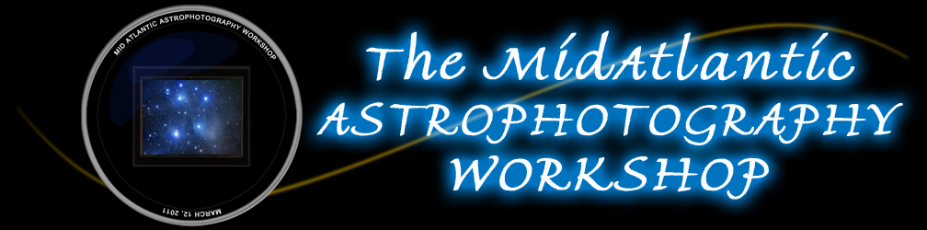
Planning for Astroimaging
Bob Traube
Trauber@aol.com – Newnebula@aol.com
www.trauber.com
March 12, 2011
George Mason University
Fairfax, Virginia

Slide 2
Topics
Astro imaging process flow
Concept Formulation
Target Information Collection
Image Planning
Test Image Capture
Thoughts on final image capture and post processing
Questions?

Slide 3
Astroimaging Process Flow

Slide 4
Concept Formulation

Slide 5
Concept Formulation What do I want to accomplish?
Imaging Objective
Interesting pictures
Capture an event
Supplement a previous image
Scientific data
Other?
Key Considerations
“Rules” of composition
Timing
Data needs
Accuracy
Your call

Slide 6
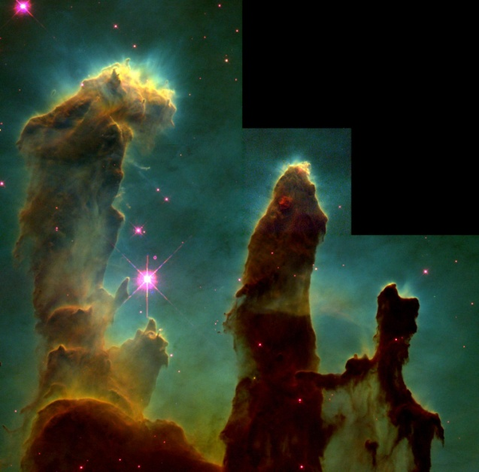
Concept Formulation What do I want to shoot tonight?
Sources of Inspiration
Image Concept

Slide 7
Information Collection

Slide 8
Target Information Collection
What do I need to know…
What is it called? (M/NGC/IC, etc.)
Where is it?
When is it visible?
How big is it?
How bright is it?
How were other pictures of it taken?
Where can I find this information?
Various star charts & planetarium software
Google/Yahoo/Bing searches
NOVAC/SEDS/User Groups and other useful links*
NASA
Your fellow astronomers
* See MAAWS handouts

Slide 9
Target Information Sources
Internet
http://tonightssky.com/ - from Earth and Sky
http://www.pa.msu.edu/abrams/SkyCalendar/Index.html
http://www.phy.duke.edu/~kolena/sky.html
Imaging Related User Groups
SBIG/Images Plus/Your Scope Here
Planetarium Software
The Sky
Starry Night
Cartes du Ciel

Slide 10
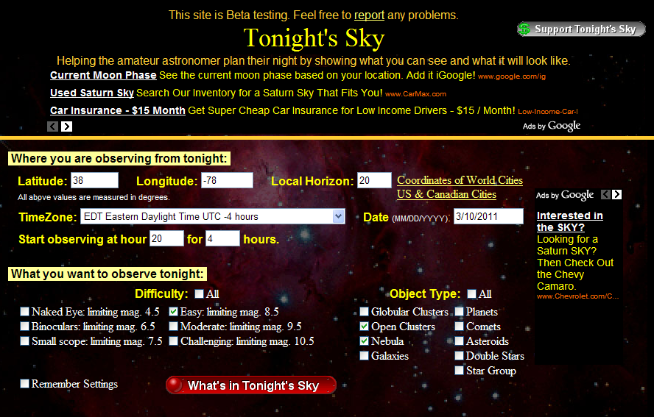
Information Collection http://tonightssky.com/

Slide 11
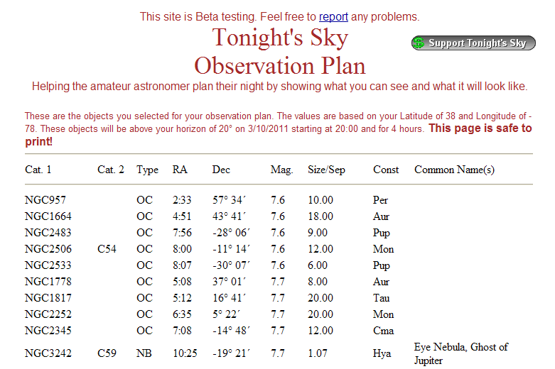
Potential Nebula and Clusters (Partial List of 65 objects found)

Slide 12
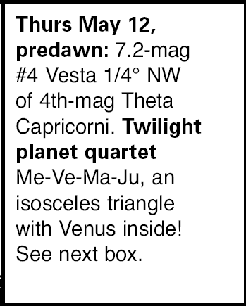
http://www.pa.msu.edu/abrams/SkyCalendar/Index.html

Slide 13
Image Planning

Slide 14
Image Planning

Slide 15
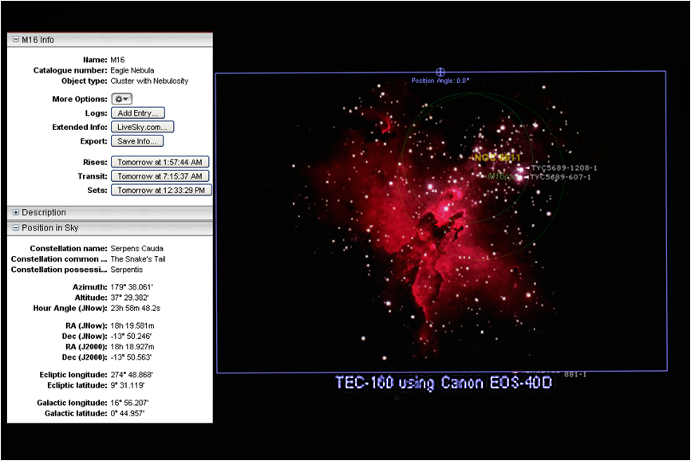
Image Planning
Starry Night Pro screen capture

Slide 16
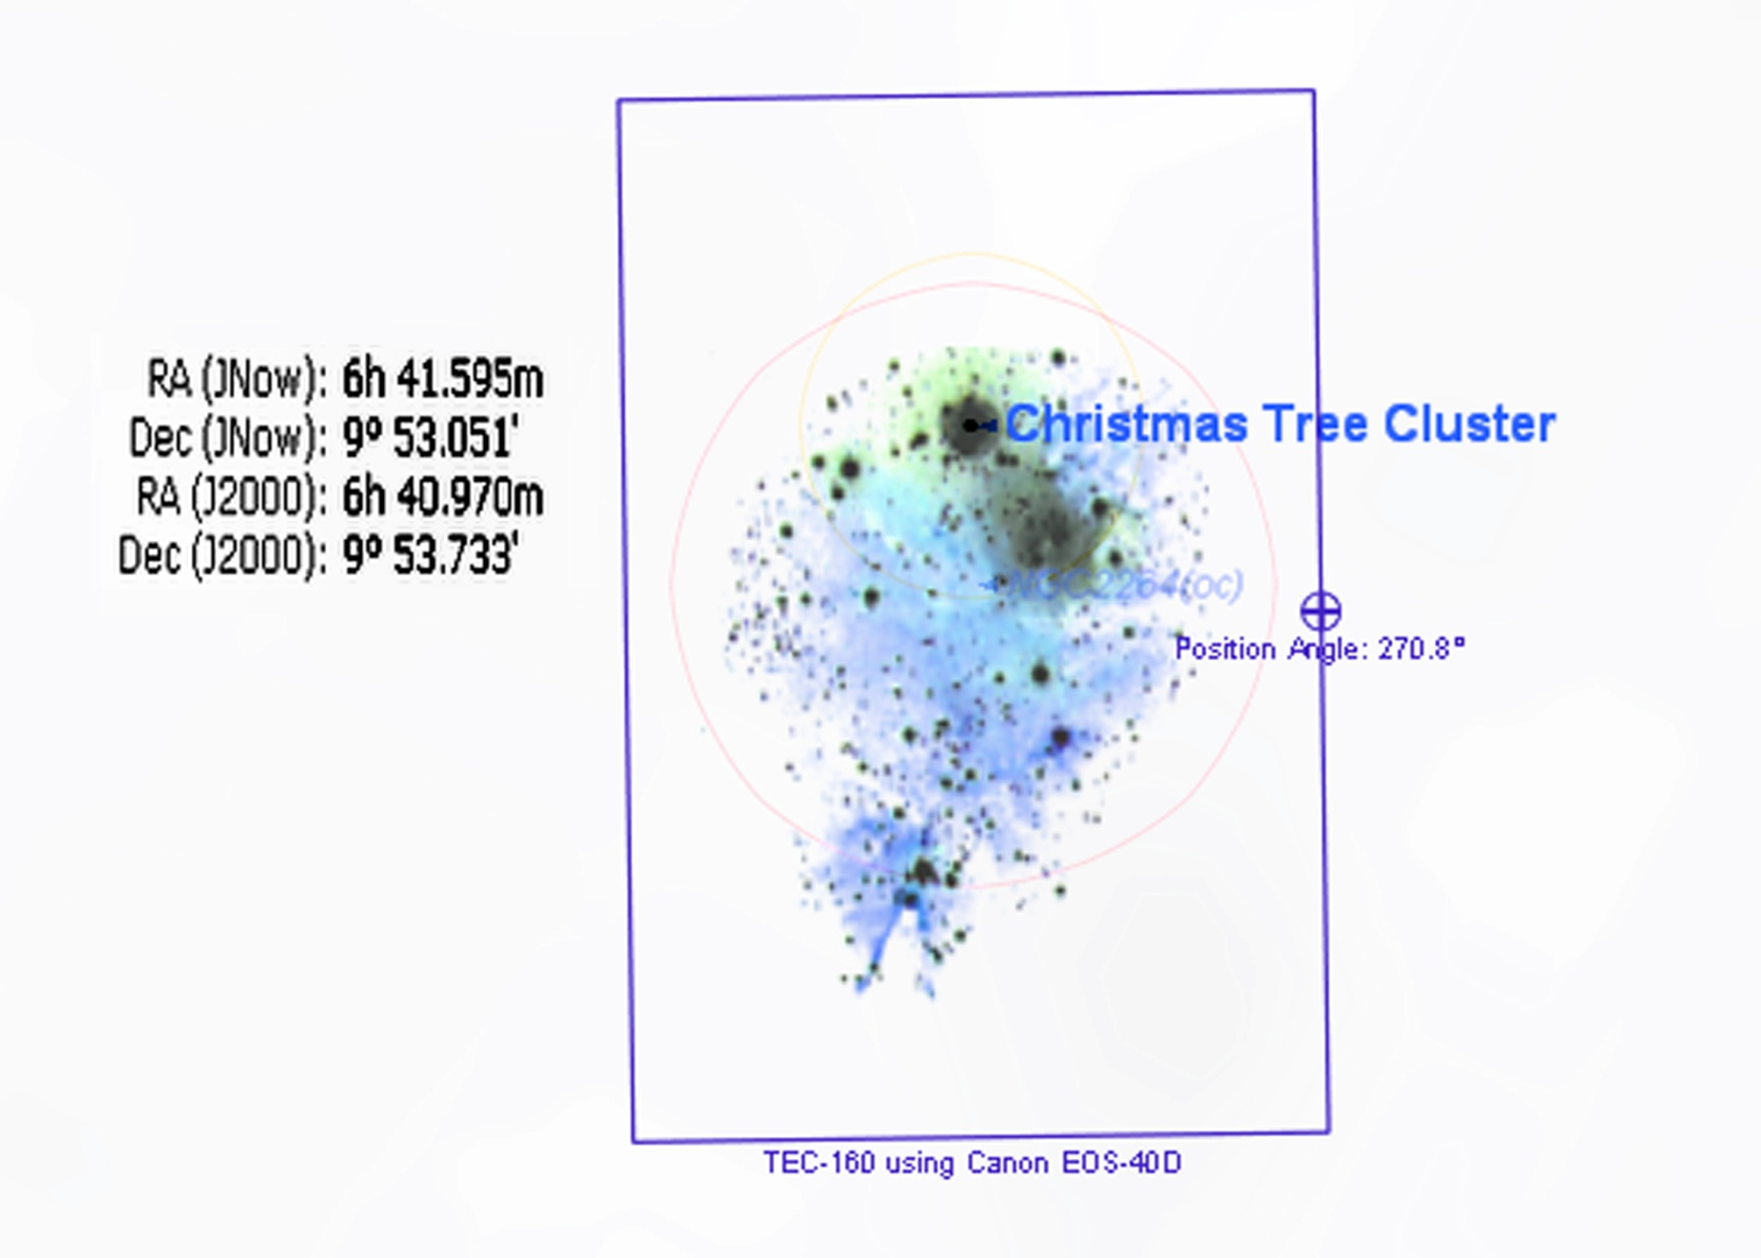
Image Planning Card

Slide 17
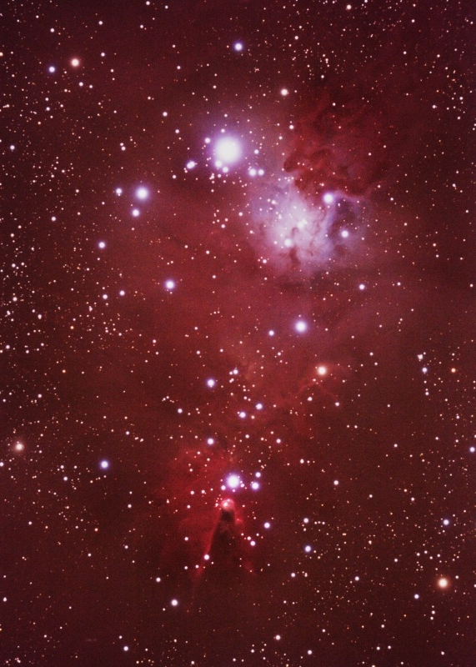
Resulting Photo

Slide 18
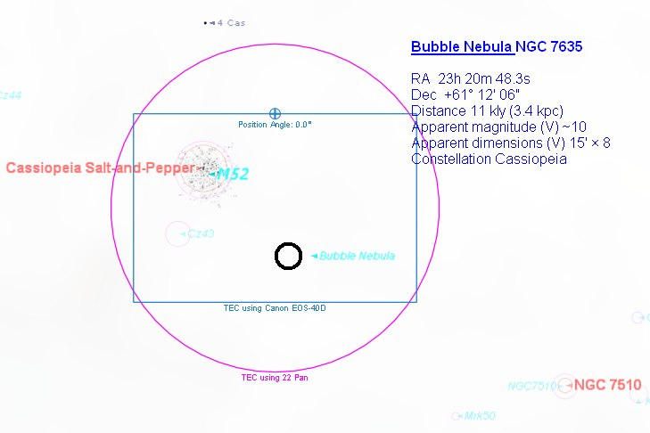
Image Planning Card

Slide 19
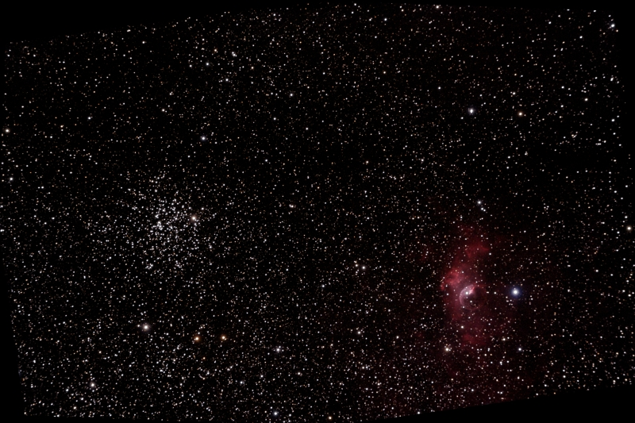
Resulting Photo

Slide 20
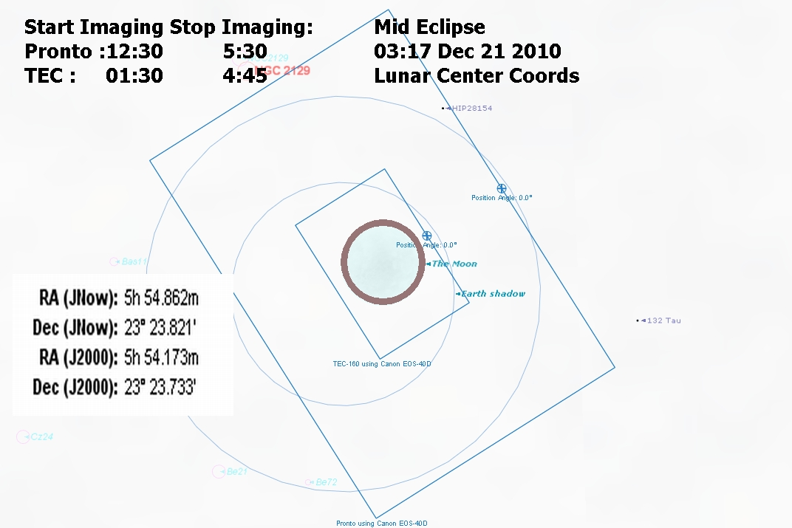
Image Planning Card

Slide 21
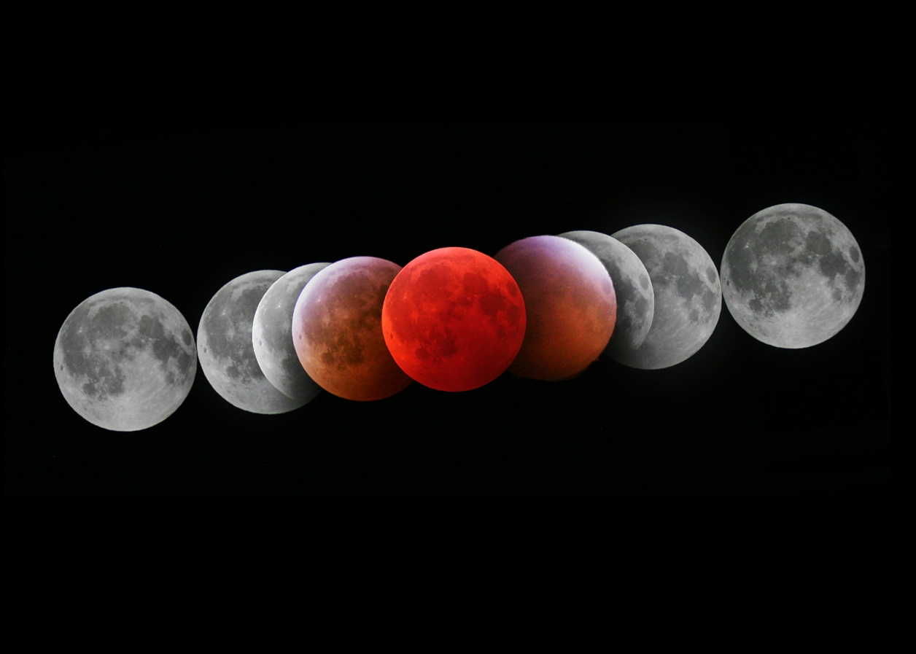
Resulting Photo

Slide 22
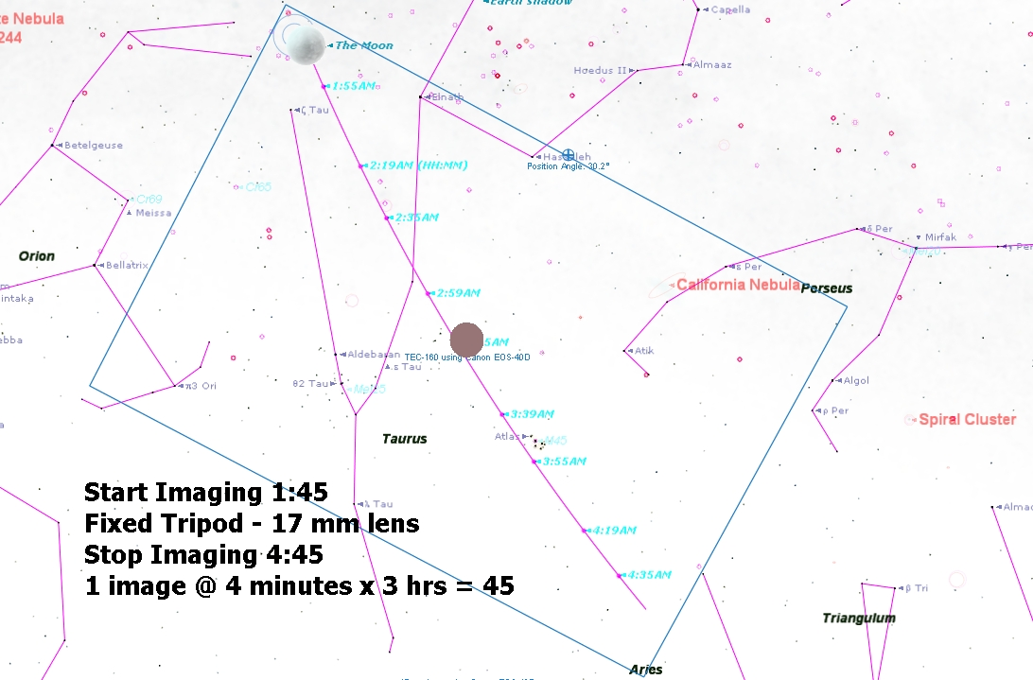
Image Planning Card

Slide 23
Image Planning

Slide 24
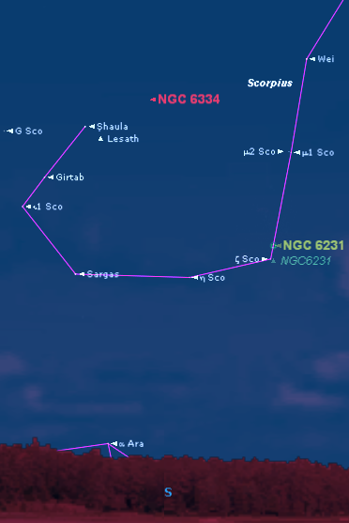
Desired Imaging time and Az-El
NGC 6334 – Cats Paw Nebula
An object near the horizon is best imaged while it crosses the meridian
Reduce atmospheric distortion
Allows for better color capture
But it limits the image duration

Slide 25
Desired Imaging time and Az-El
Time specific event considerations
Pre sync time with official source
http://www.time.gov/timezone.cgi?Eastern/d/-5
http://www.docgoerlich.de/utcdate.php (for Gemini)
Set up earlier than usual, allow for contingencies
Take several test images if possible
Examples

Slide 26
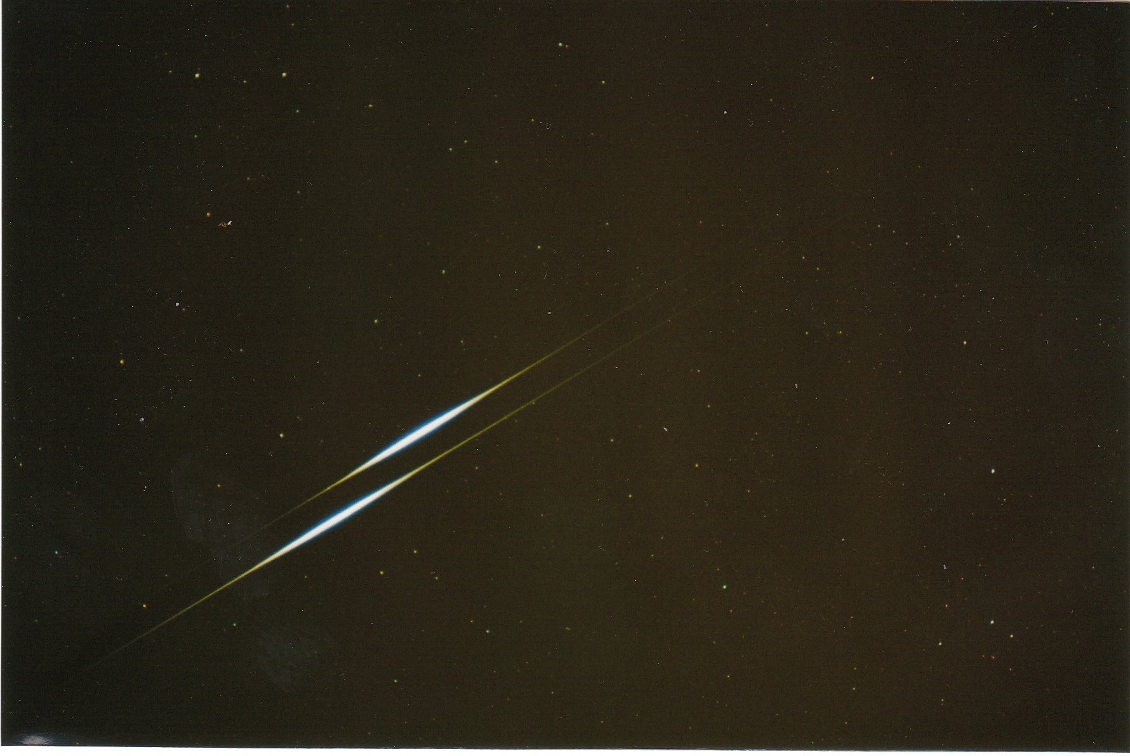
Double Iridium Flare

Slide 27
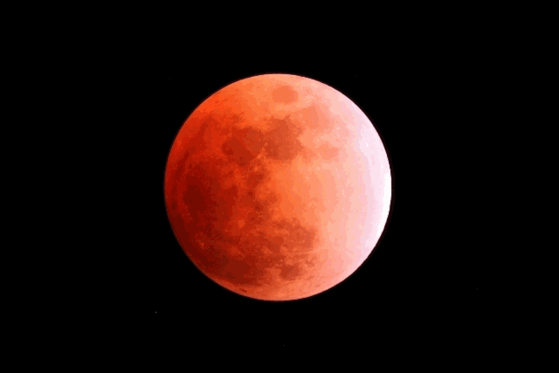
Lunar Eclipse Feb 20 2008

Slide 28
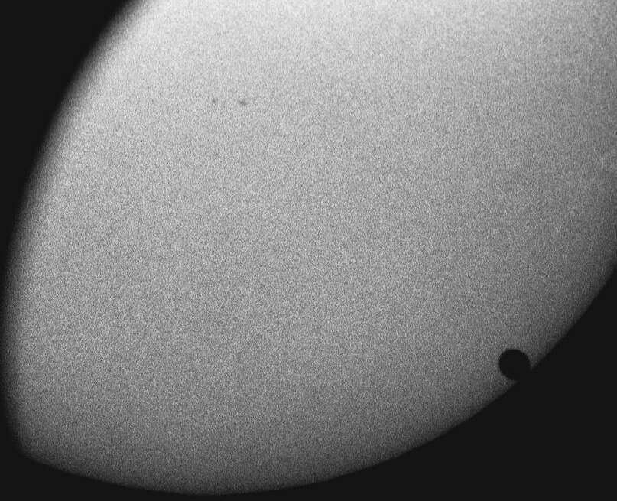
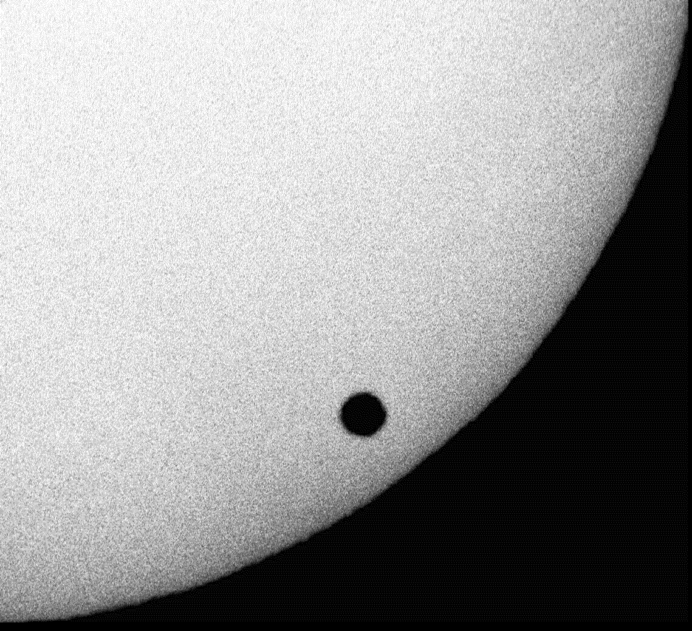
Venus Transit

Slide 29
Timed Events
Other examples
Jupiter moon and shadow transits
Comets near other objects
ISS/Shuttle Passes
Solar Eclipse
Potential Sources
Heavens-Above.com
http://www.minorplanetcenter.org/iau/Ephemerides/Comets/index.html
Animated GIF Creator
http://www.myspacegens.com/handler.php?gen=animatedimage

Slide 30
Test Image Capture

Slide 31
Test Image Results
Check for Focus, Exposure and Composition
Test Image
Adjustment
Focus
Exposure
Composition
Zoom on nearby star
Is histogram balanced?
No zero pixels
“No” saturated pixels
Reasonable sky glow
1st test image to confirm target and orientation (~3 min)
Next test images shorter to confirm orientation adjustments (~1 min)
Refocus
Adjust sub image exposures
Re point telescope and rotate camera

Slide 32
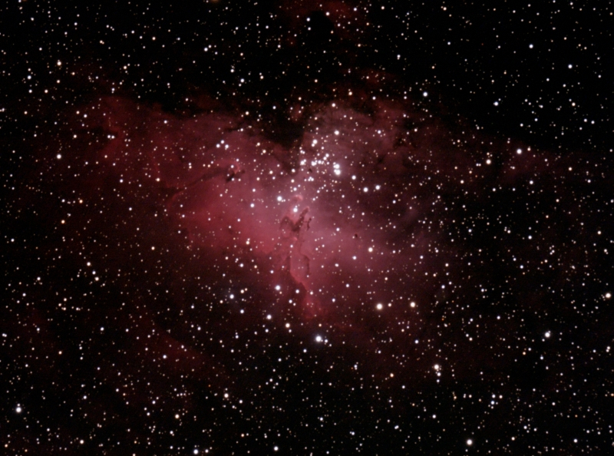
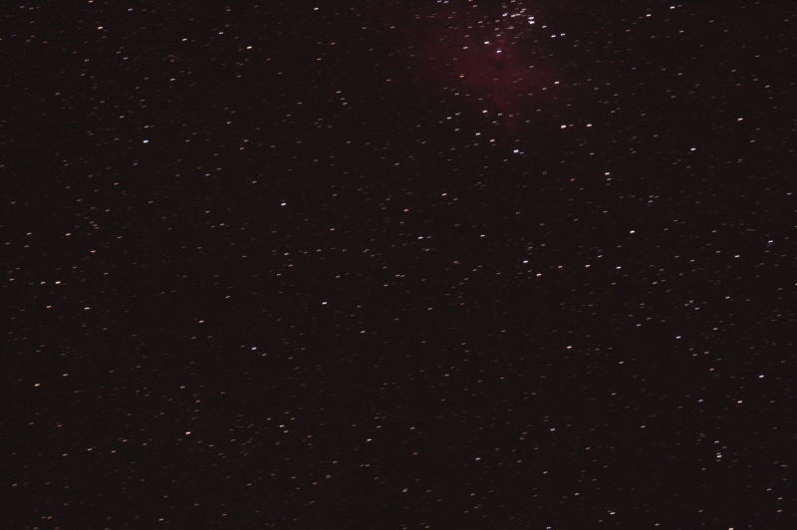
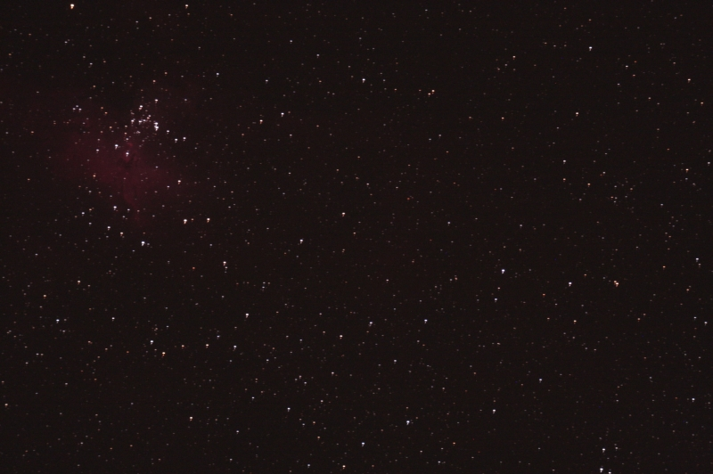
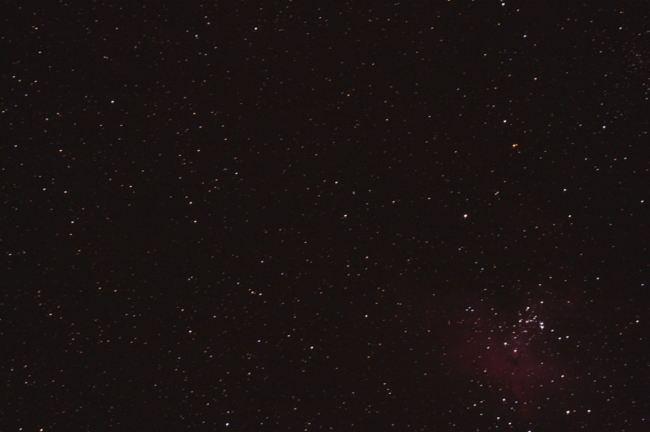
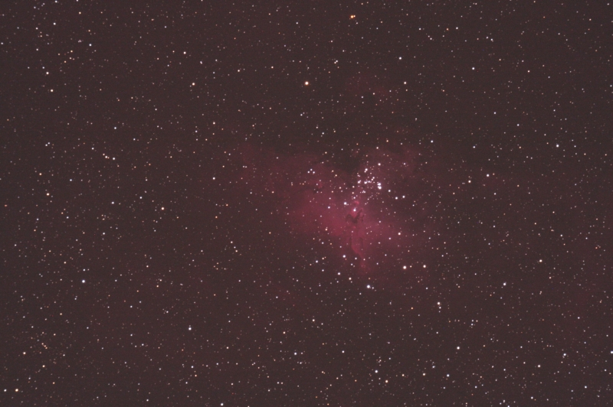
Image Centering Example

Slide 33
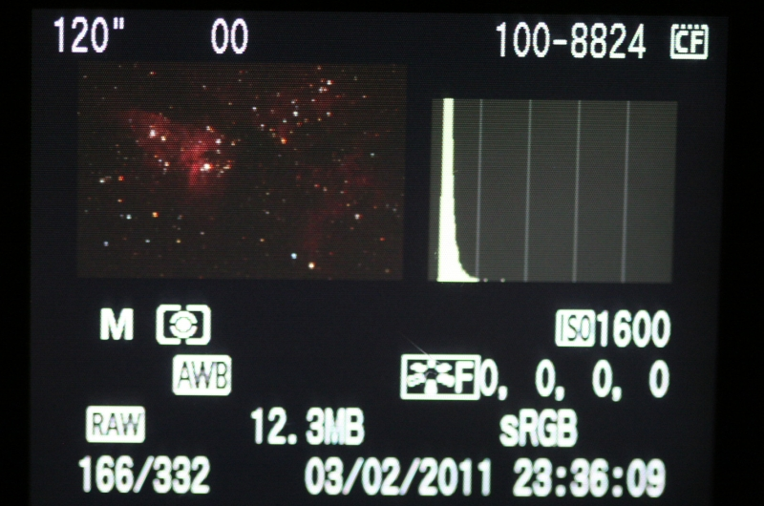
On Camera Histogram

Slide 34
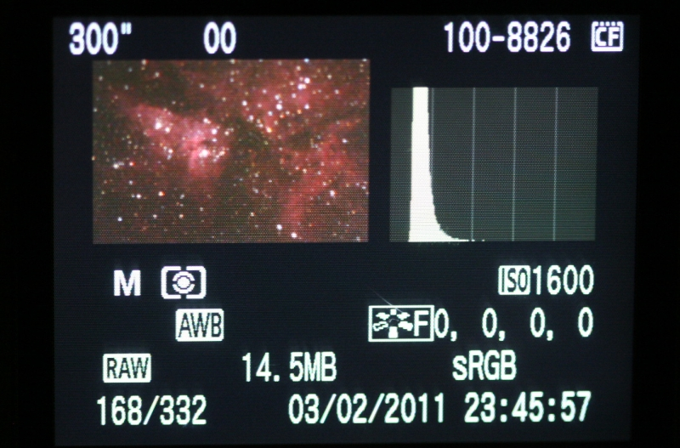

Slide 35
Final Thoughts on Image Planning
“No amount of planning will ever replace dumb luck.”
Jerry Lodriguss
Plan the image but don’t let the planning get in the way of a good picture!
Learn from you previous images – apply it.
Be flexible and creative, and above all…
Have fun!

Slide 36
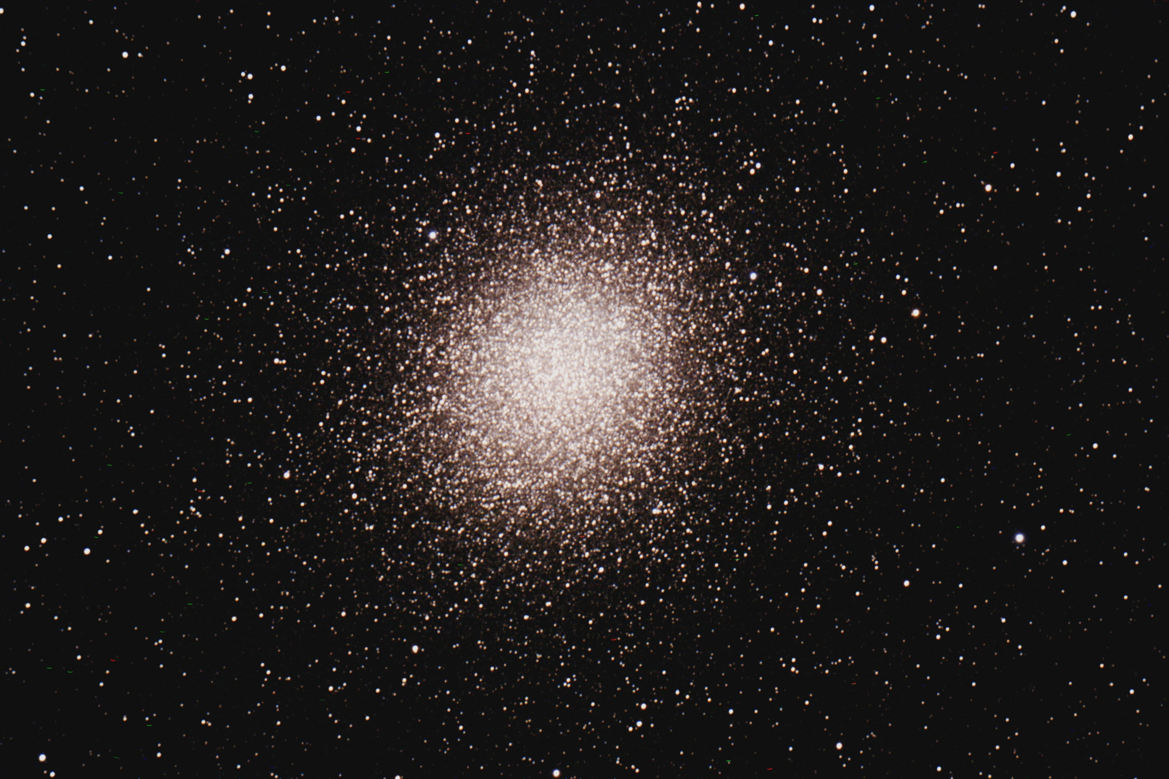
Questions?

